Slide 1
Causal Inference
Holly Toner
April – July 2021
Notes:
Hello and welcome to this team talk on Causal Inference, I’ll start off today by introducing myself

Slide 2




BSc Mathematics, MSc Software Development
Joined Kainos November 2020
Software Engineer in the Innovation team
Notes:
My name is Holly and to give a bit of background on me I completed my undergraduate degree in maths. With most of my focus around pure maths and statistics.
Before uni I would have labelled myself as IT illiterate, but I found myself thrown in the deepend when so many of the modules I undertook involved mathematical modeling in Python.
It wasn’t long before I caught the bug for code and when my 3 years in maths were over, I went on to do a conversion masters in Software Development.
I’m still a relative newbie – I joined Kainos through the Engineering Academy towards the end of 2020.
Since then, I have been working within the Applied Innovation Team.

Slide 3
What is
Causal Inference?
Notes:
- Causal Inference may be a term that is new to many of you. It certainly was new to me several weeks ago when we started to explore the space.
- This talk will aim to shine some light on what causal inference is, the value that it brings and the tools that currently exist is the space.
- But before I get too deep into that I'd like to first introduce the problem that Causal Inference seeks to solve.

Slide 4
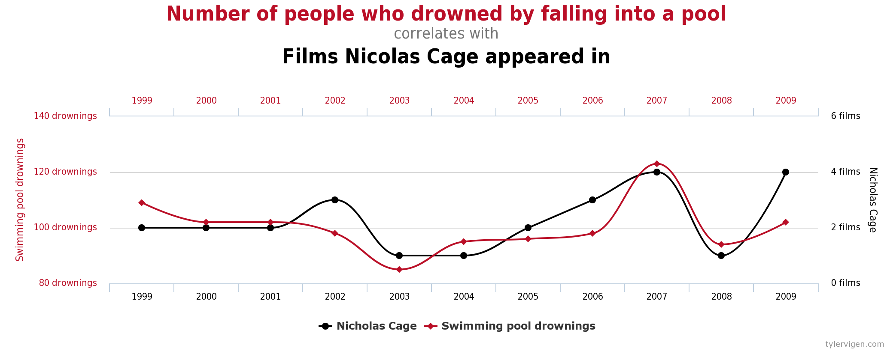
Notes:
- This first graph plots the number of people drowned by falling into a pool against the Number of films Nicholas Cage appeared in per year.
- As you can see there is a strong correlation between these two variables, and this begs the worrying question "What would happen to drowning rates if Nicholas Cage appeared in 10 films in 2010?"
- Thankfully, that didn't happen!

Slide 5
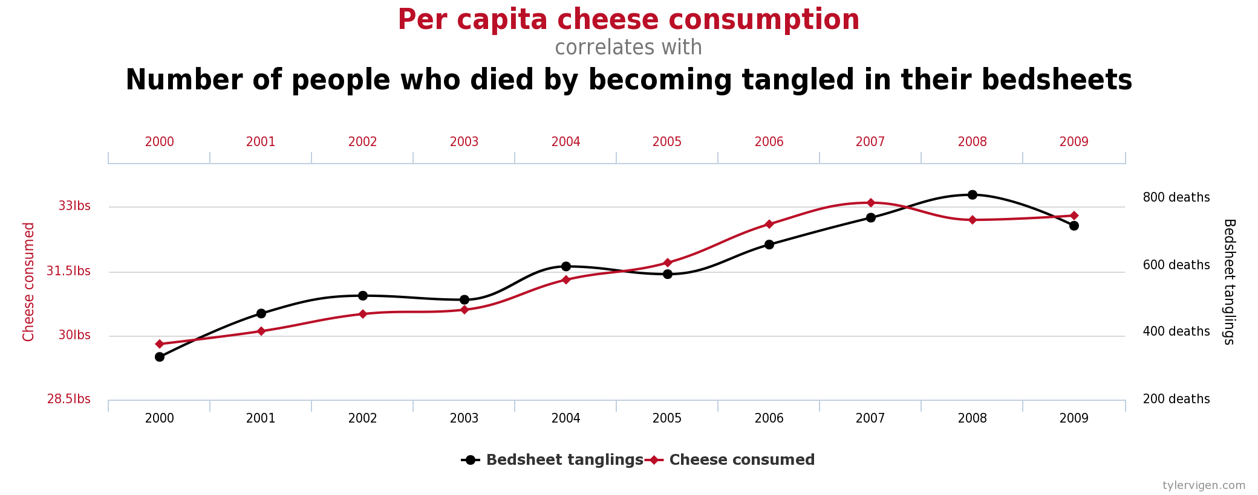
Notes:
- And likewise, here is a measure of cheese consumption per capita against the number of people who died by becoming tangled in their bedsheets.
- Once again, we ask ourselves - What would to happen to bedsheet tangling's if cheese consumption suddenly shot up the next year?

Slide 6
And Statistics"
"Lies, damned lies,
Notes:
- The famous quote from Mark Twain say there are 3 types of lies: lies, damned lies and statistics
- If our understanding was based on the correlation of the data alone, that is the statistics put in front of us – the data may lead us to believe there is a physical relationship between these two attributes.
- If we trusted the correlation entirely we might believe that consuming cheese CAUSED a person to tangle themselves in their bed sheets.

Slide 7
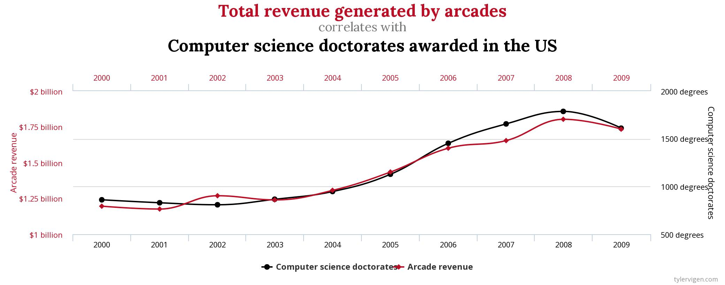
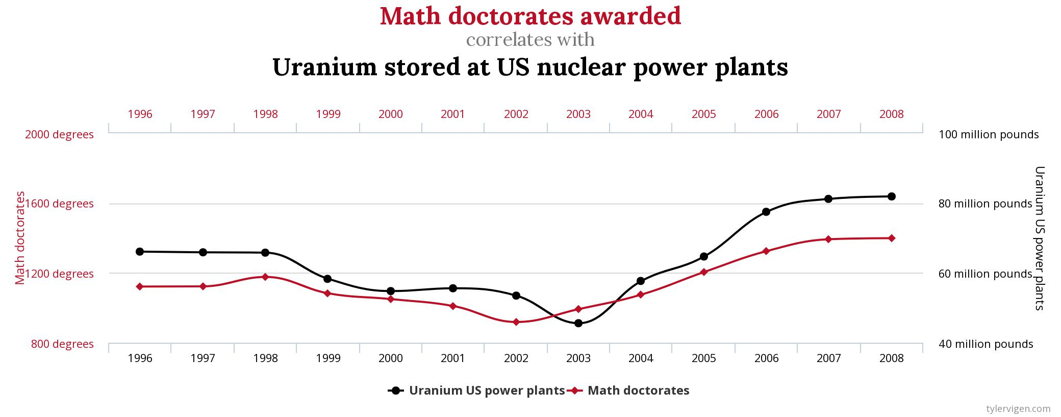
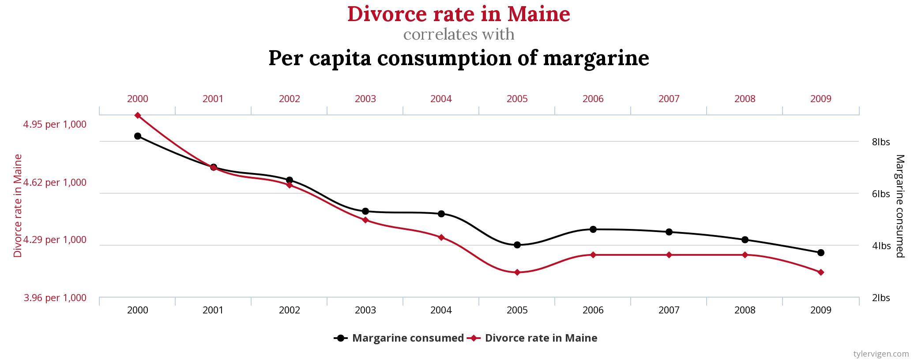
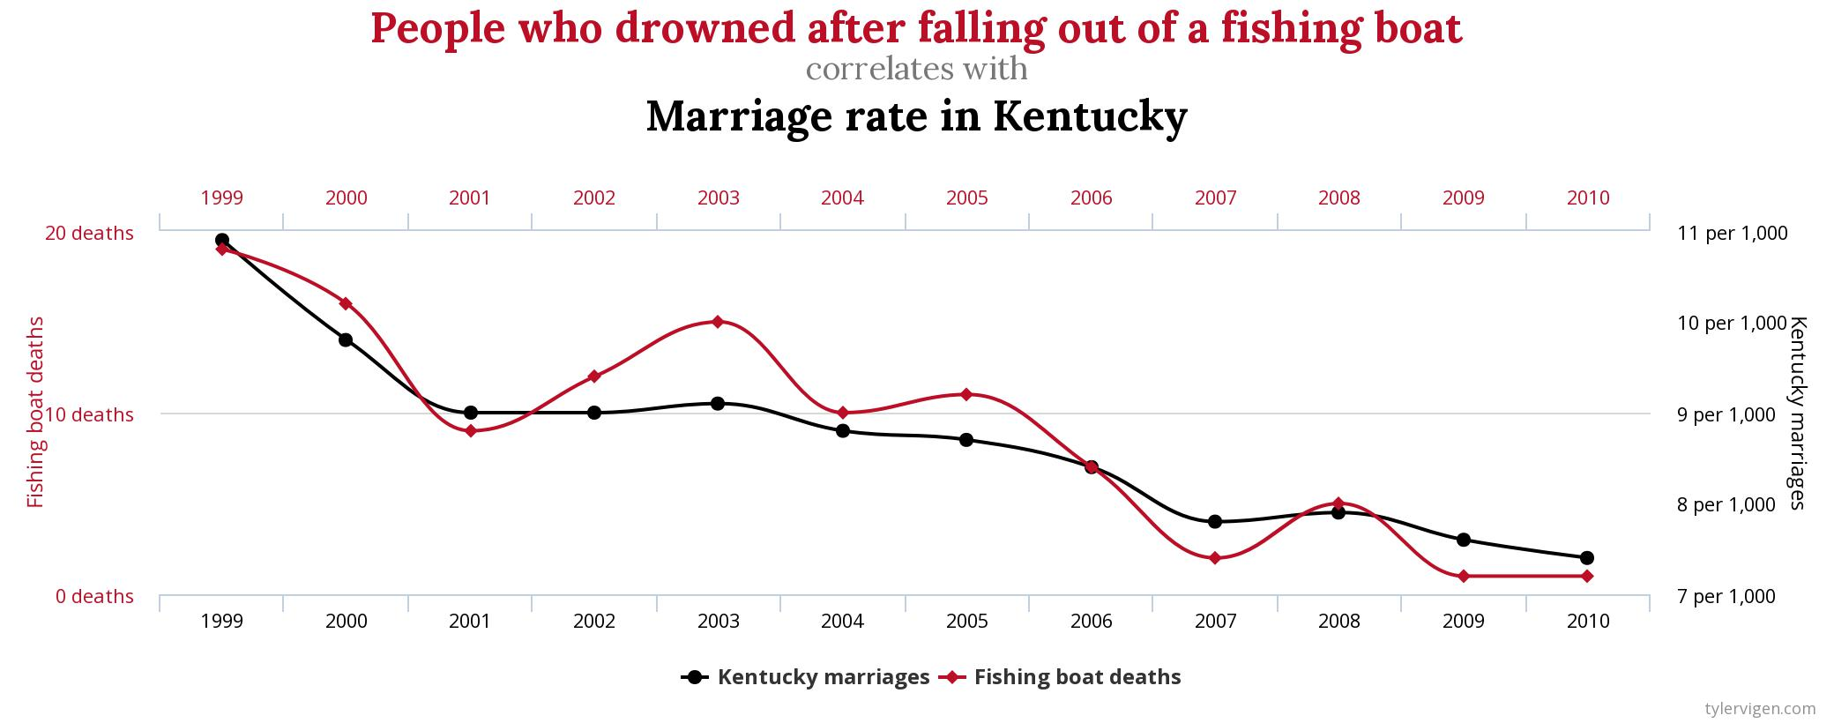
Notes:
- There are a huge number of silly examples of correlations found in seemingly unrelated features. And you will certainly get a chuckle from having a look at them online.
- But...

Slide 8

Correlation $≠$ Causation
Why is this a Problem?
Notes:
Boiled down, what we are saying is that correlation does not unfortunately equal causation.
In the examples we have looked at so far it has been obvious that the correlations observed are not evidence of causation.
Without too much thought or effort we can reason that the number of movies Nicholas cage appeared in this year will have no effect on how many people will drown.
The problems start to arise when things are less obvious, when we observe correlation between two variables, and it makes sense in our minds that one of these things could be causing the other.
But just because something makes sense doesn’t mean it's true. And we can’t allow ourselves to fall into the trap of believing correlation infers causality.
So, this is causing issues in our understanding of certain problem domains. But the problems that arise from misunderstanding causation go much further …

Slide 9
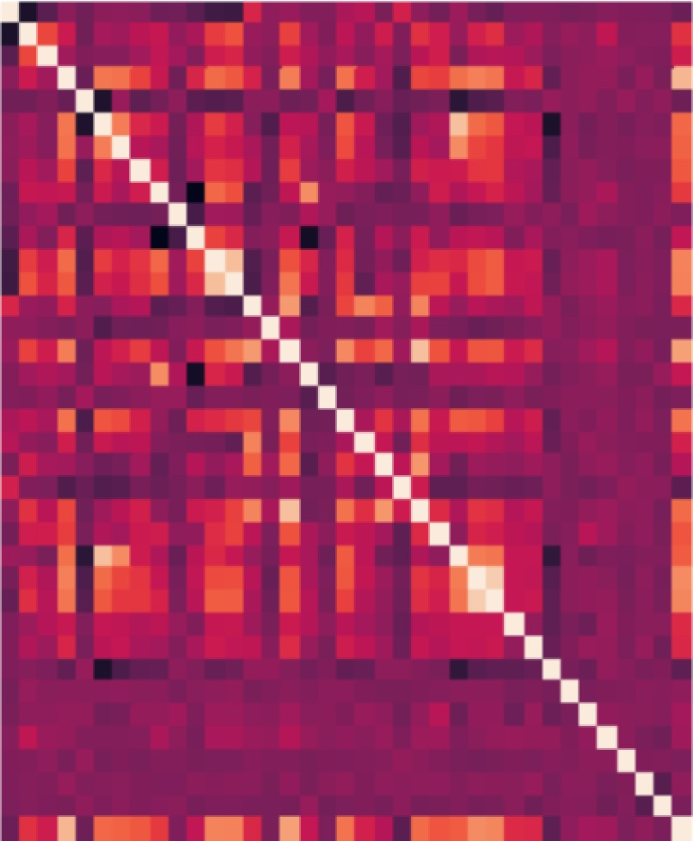



Machine Learning
Correlation Heatmap
Feature Selection
Adding Noise
Notes:
For many data scientists the first step in exploring a new dataset and getting a better understanding is to create a correlation heatmap.

Slide 10



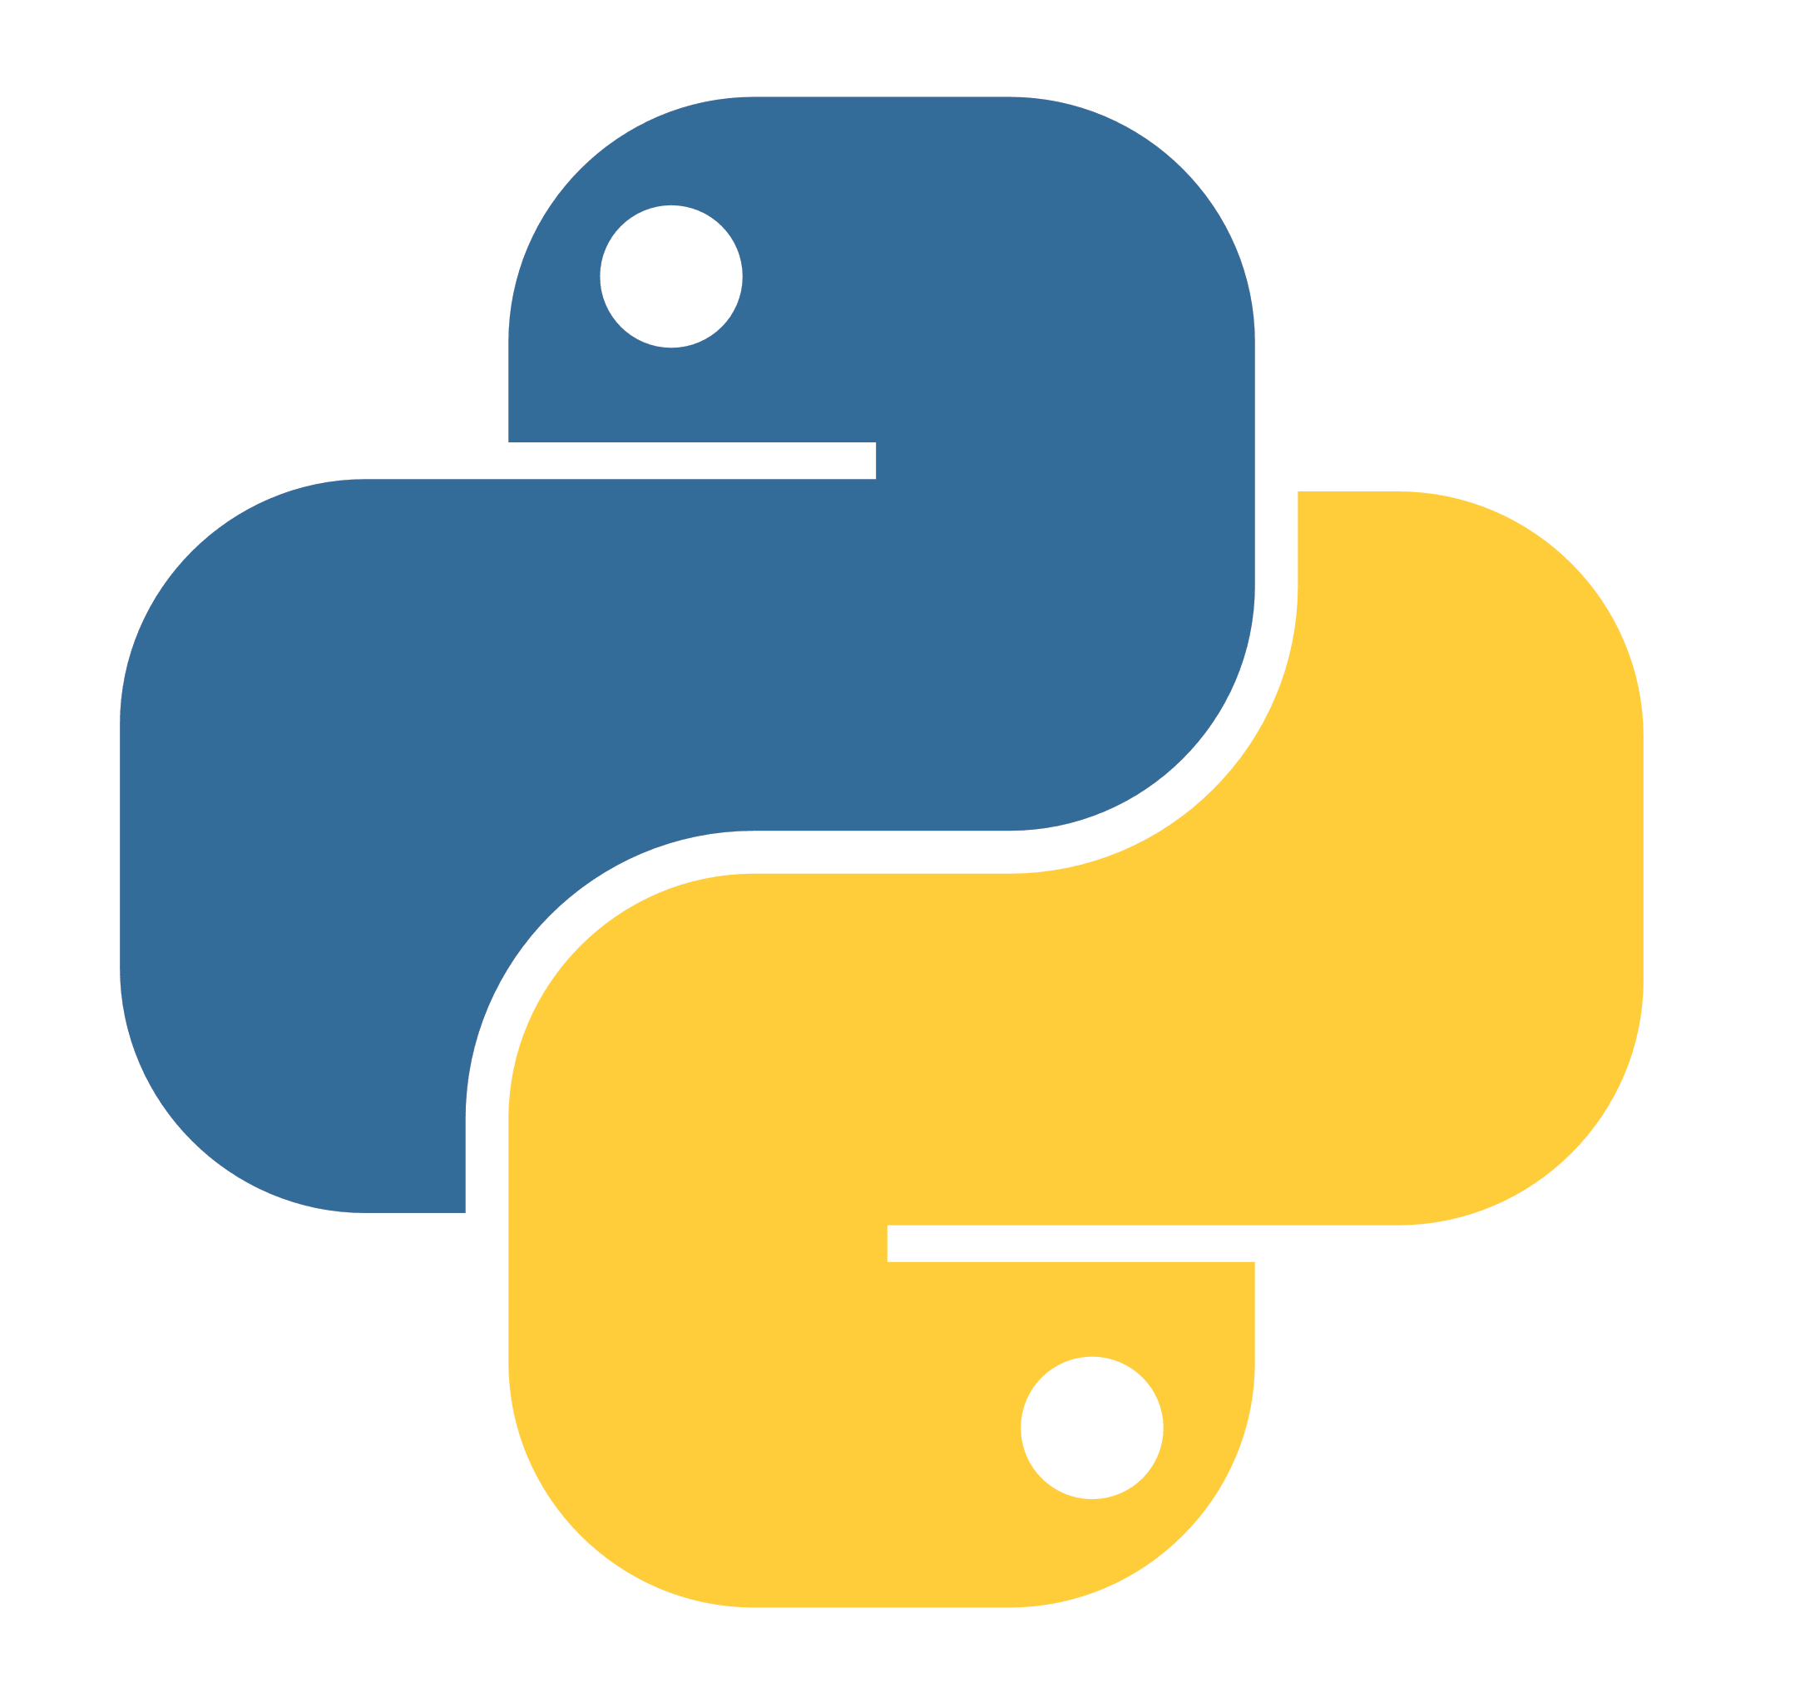

Causal Tools
DoWhy
4 Step tool for modelling a problem, estimating causal inference, and testing assumption validity & robustness.
CausalML
Provides a suite of uplift modelling and causal inference methods using machine learning algorithms.
EconML
Package used by DoWhy for estimating heterogeneous treatment effects from observational data via machine learning.
CausalImpact
Estimates the causal effect of a designed intervention on a time series.
DoWhy
4 Step tool for modelling a problem, estimating causal inference, and testing assumption validity & robustness.
CausalML
Provides a suite of uplift modelling and causal inference methods using machine learning algorithms.
Notes:
Uber CausalML
Microsoft EconML

Slide 11
Causal Tools
DoWhy
4 Step tool for modelling a problem, estimating causal inference, and testing assumption validity & robustness.
CausalML
Provides a suite of uplift modelling and causal inference methods using machine learning algorithms.
EconML
Package used by DoWhy for estimating heterogeneous treatment effects from observational data via machine learning.
CausalImpact
Estimates the causal effect of a designed intervention on a time series.
DoWhy
4 Step tool for modelling a problem, estimating causal inference, and testing assumption validity & robustness.
CausalML
Provides a suite of uplift modelling and causal inference methods using machine learning algorithms.
Notes:
Google CausalImpact – great with timeseries data

Slide 12
Causal Tools
DoWhy
4 Step tool for modelling a problem, estimating causal inference, and testing assumption validity & robustness.
CausalML
Provides a suite of uplift modelling and causal inference methods using machine learning algorithms.
EconML
Package used by DoWhy for estimating heterogeneous treatment effects from observational data via machine learning.
CausalImpact
Estimates the causal effect of a designed intervention on a time series.
DoWhy
4 Step tool for modelling a problem, estimating causal inference, and testing assumption validity & robustness.
CausalML
Provides a suite of uplift modelling and causal inference methods using machine learning algorithms.
Notes:
Investigated a number of different tools
Uber have developed CausalML a python library that is quite similar to EconML. Both provide a methods to test causality using machine learning.
Typical use cases Campaign Targeting Optimization which aims to increase return on investment by measuring the effect of ad exposure on a specific KPI.
Another use case is Personalized Engagement where companies many different options on how to engage their customer base. Causal models can be used to achieve the greatest effect that can be achieved by finding the optimal treatment or in this case the optimal communication type.

Slide 13
Causal Tools
DoWhy
4 Step tool for modelling a problem, estimating causal inference, and testing assumption validity & robustness.
DoWhy
4 Step tool for modelling a problem, estimating causal inference, and testing assumption validity & robustness.
CausalML
Provides a suite of uplift modelling and causal inference methods using machine learning algorithms.
EconML
Package used by DoWhy for estimating heterogeneous treatment effects from observational data via machine learning.
CausalImpact
Estimates the causal effect of a designed intervention on a time series.
CausalML
Provides a suite of uplift modelling and causal inference methods using machine learning algorithms.
Notes:
-- The most extensive tool we found in our research was undoubtedly Microsoft DoWhy, once again this tool comes in the form of a python library.
- The differentiating factor with Microsoft's DoWhy tool is the fact that it allows you to build into your tests your own logic and understanding of the features. For example, we would be able to tell the model if we were certain one feature was the causation of another. We call this understanding "Domain Specific Knowledge". When we consider the healthcare space an important customer base for Kainos. We can work closely with our customers to using their specialised knowledge to improve the performance and explain ability.

Slide 14
Causal Inference Today
Machine Learning
Causal Estimate
Feature Selection
Notes:
Where is causal inference now and what does the future of the space look like?
In the example that we have seen today, DoWhy is using Machine Learning models under the hood to create estimates of how much of an effect one even has on another. We have discussed how that process can be used manually today during exploratory data analysis to improve our machine learning models in a very manual way.
In the coming years we expect to see this process becoming integrated with pipelines or machine learning models themselves to create more robust models and improve the explain ability of Machine learning models.

Slide 15
Future of Causal Inference
Machine Learning
Causal Estimate
Feature Selection
Notes:
Where is causal inference now and what does the future of the space look like?
In the example that we have seen today, DoWhy is using Machine Learning models under the hood to create estimates of how much of an effect one even has on another. We have discussed how that process can be used manually today during exploratory data analysis to improve our machine learning models in a very manual way.
In the coming years we expect to see this process becoming integrated with pipelines or machine learning models themselves to create more robust models and improve the explain ability of Machine learning models.

Slide 16
QUESTIONS

Slide 17
Holly Toner
h.toner@kainos.com
Contact me on LinkedIn
Notes:
My name is Holly and to give a bit of background on me I completed my undergraduate degree in maths. With most of my focus around pure maths and statistics.
Before uni I would have labelled myself as IT illiterate, but I found myself thrown in the deepend when so many of the modules I undertook involved mathematical modeling in Python.
It wasn’t long before I caught the bug for code and when my 3 years in maths were over, I went on to do a conversion masters in Software Development.
I’m still a relative newbie – I joined Kainos through the Engineering Academy towards the end of 2020.
Since then, I have been working within the Applied Innovation Team.

